Slide 1

Unleashing the Creative Power of AI

Slide 2
Outline
Introduction to Generative AI
Applications of Generative AI
Challenges of Generative AI
Future of Generative AI
Ethics and Regulation in Generative AI
Conclusion

Slide 3
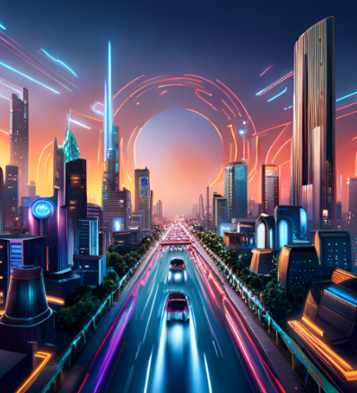
Introduction to Generative AI
Generative AI is a subfield of artificial intelligence that focuses on creating machines capable of generating new and original content. This can include anything from images and videos to music and text.
Unlike traditional AI, which relies on pre-existing data sets to make predictions or decisions, generative AI uses algorithms to create new content based on patterns and trends found in the data it is trained on.

Slide 4

Applications of Generative AI
Generative AI has numerous applications across a variety of industries, including art, music, fashion, and gaming. For example, generative AI can be used to create unique pieces of artwork or design custom clothing based on customer preferences.
In the gaming industry, generative AI can be used to create realistic environments and characters, or even generate entire game levels on the fly. In the field of medicine, generative AI can be used to analyze medical images and assist doctors in making diagnoses.

Slide 5

Challenges of Generative AI
While generative AI has many exciting applications, there are also several challenges associated with the technology. One major challenge is ensuring that the generated content is ethical and does not perpetuate harmful stereotypes or biases.
Another challenge is ensuring that the generated content is of high quality and meets certain standards. This can be particularly difficult in fields such as music and art, where subjective judgments play a large role in determining quality.

Slide 6

The future of generative AI is both exciting and uncertain. As the technology continues to advance, we can expect to see even more impressive applications and use cases emerge.
However, there are also concerns about the impact that generative AI could have on society, particularly with regards to job displacement and the potential for misuse or abuse of the technology.
Future of Generative AI

Slide 7

Ethics and Regulation in Generative AI
As generative AI becomes more prevalent, it is important to consider the ethical implications of the technology. This includes issues such as bias, privacy, and transparency.
Regulation will also play an important role in ensuring that generative AI is used responsibly and ethically. Governments and organizations around the world are already beginning to develop frameworks and guidelines for the use of AI, and this trend is likely to continue as generative AI becomes more widespread.

Slide 8

Conclusion
Generative AI is a rapidly evolving field with numerous exciting applications and potential benefits. However, it is important to approach the technology with caution and ensure that it is used responsibly and ethically.
By addressing the challenges and concerns associated with generative AI, we can work towards a future where this technology is able to benefit society in meaningful ways.

